Slide 1
Scalable Address Spaces Using RCU Balanced Trees
Austin T. Clements M. Frans Kaashoek Nickolai Zeldovich

Slide 2
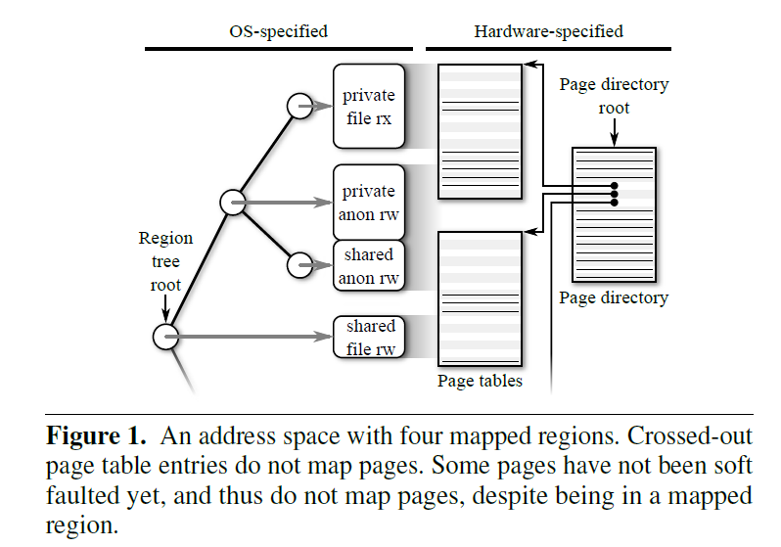
Address space
memory mapping regions
page table tree

Slide 3
Three address space operations
mmap system calls
munmap system calls
page faults

Slide 4
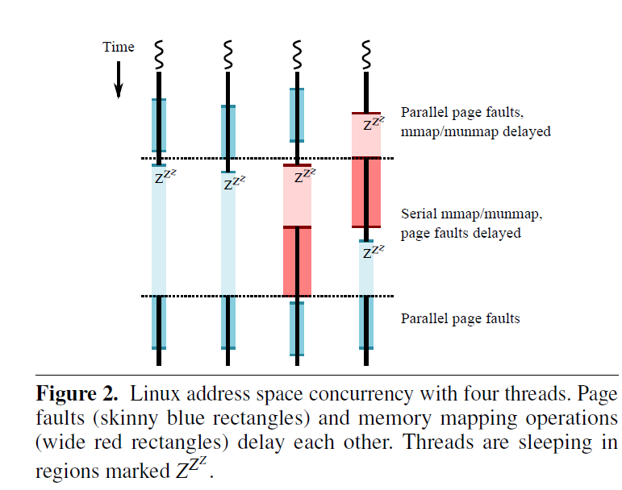
A single read/write lock per process
serializes page faults and memory mapping operations

Slide 5
Make page faults scale to large numbers of cores
Addressing two basic forms of serialization
allow soft page faults to run concurrently with mmap and munmap operations to eliminate serialization on the per-process read/write lock.
make page faults run without modifying shared cache lines to eliminate serialization

Slide 6
New concurrent address space design
Applying read-copy-update (RCU) to the VM system by introducing the BONSAI tree
An RCU-based concurrent balanced tree used as part of the design.

Slide 7
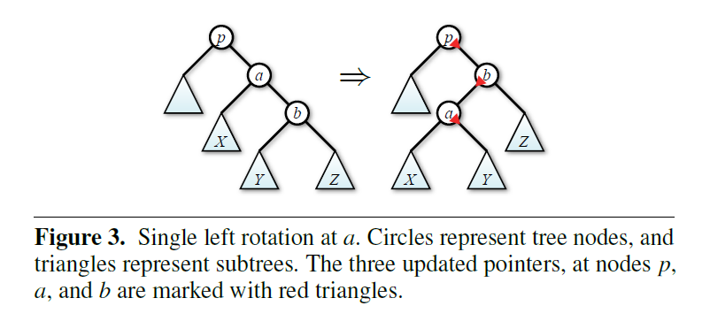

Slide 8
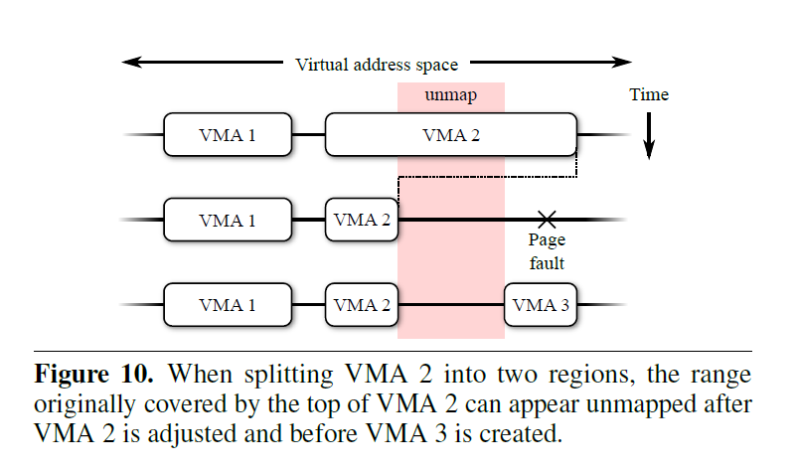

Slide 9
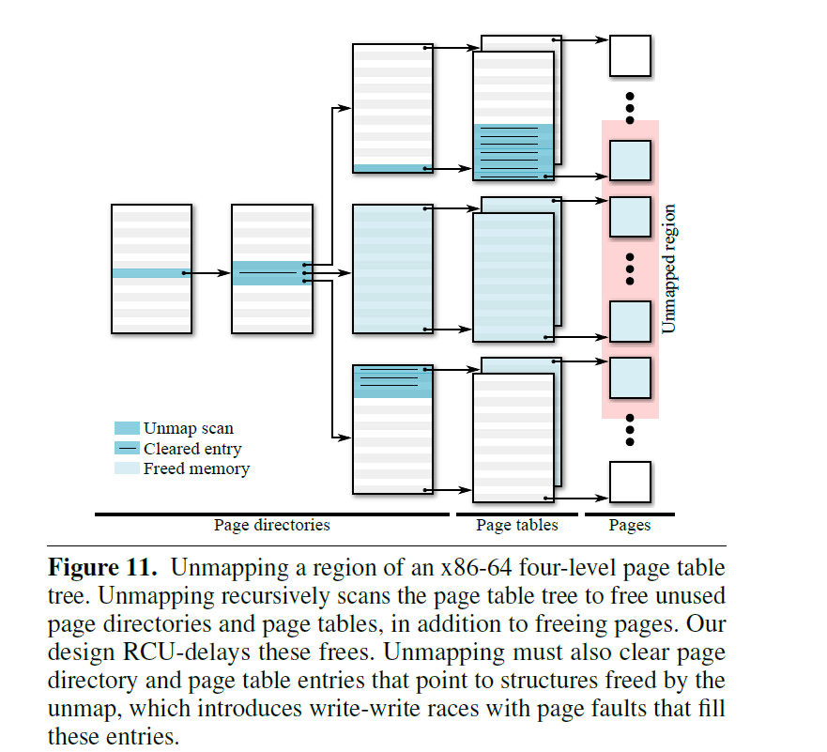

Slide 10
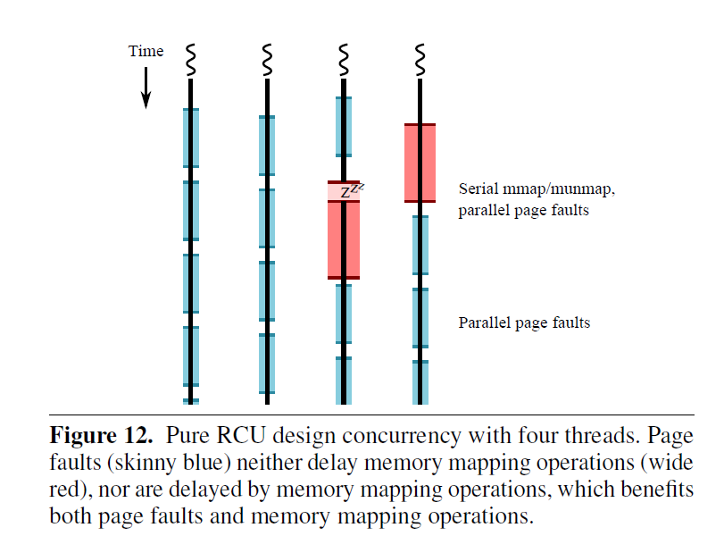

Slide 11
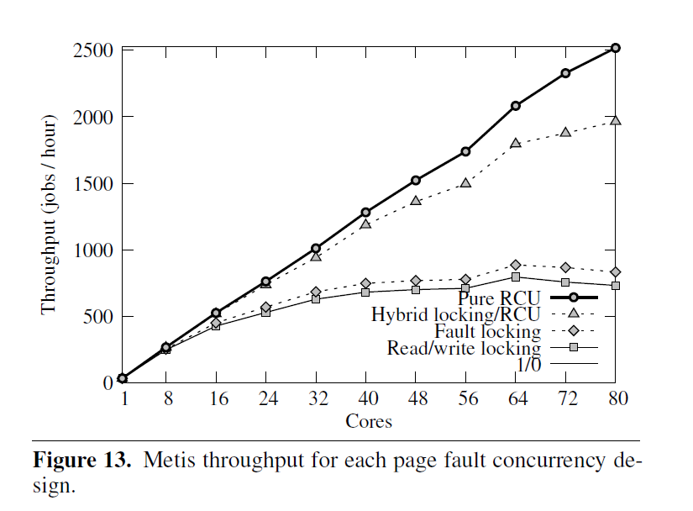
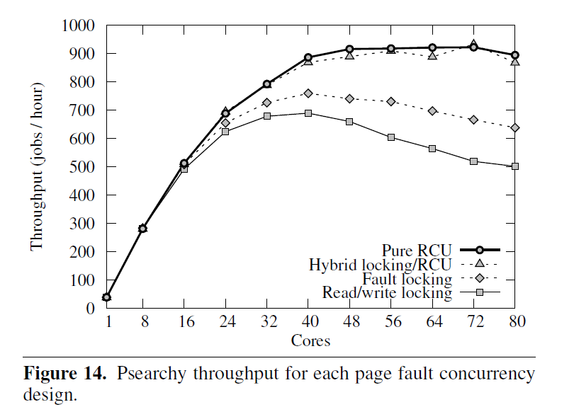

Slide 12
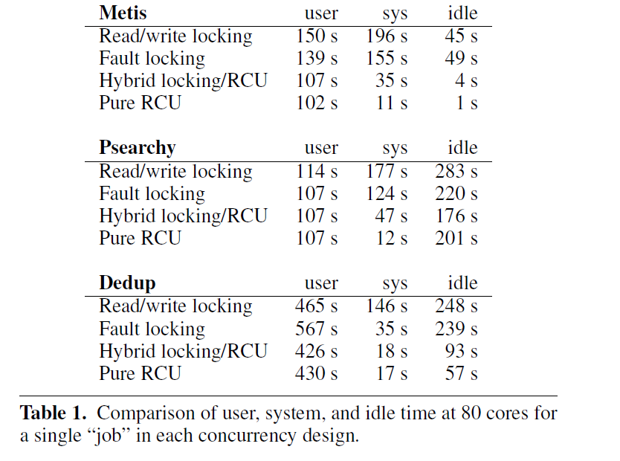

Slide 13
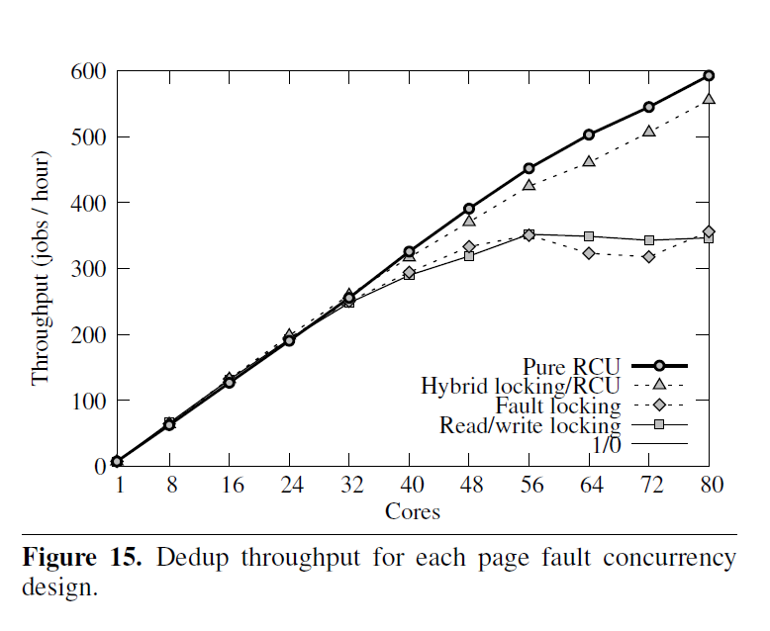

Slide 14
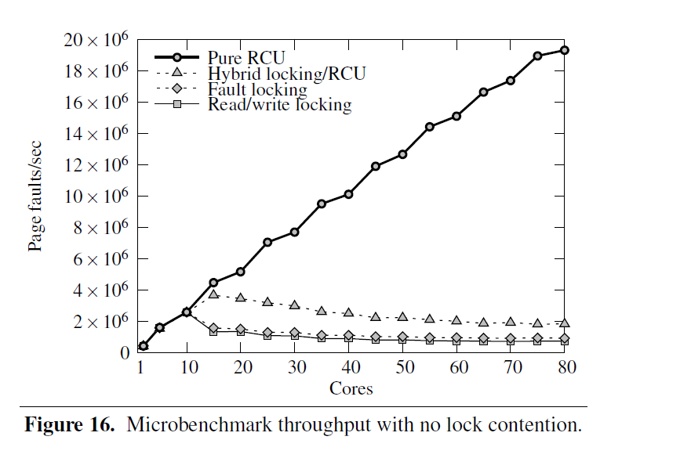

Slide 15
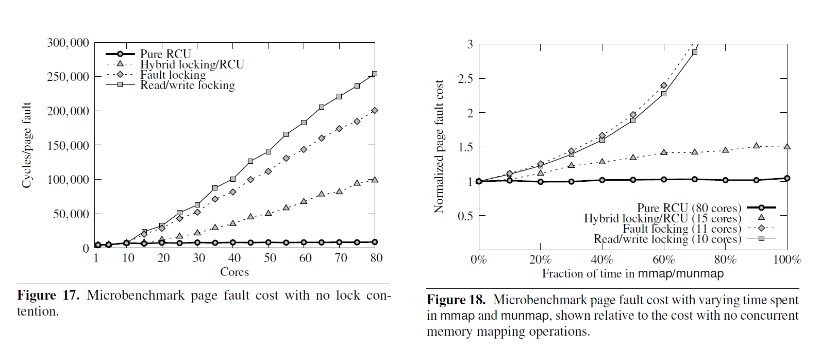

Slide 16
Evaluate
Tmplement our concurrent address space design in Linux 2.6.37.
Leverages the BONSAI tree to apply RCU pervasively to both page table and tree operations
Performance improvements on 80 cores ranging from 1.7 to 3.4 for an implementation of this design in the Linux 2.6.37 kernel.

Slide 17
Contribution
a novel design for an RCU-compatible balanced tree (BONSAI)
a new address space design that uses BONSAI to achieve highly-scalable page fault handling, an implementation of that design in Linux
an experimental evaluation using applications and microbenchmarks on an 80 core machine.

Slide 18
END

